Slide 1
Machine Learning in R
Eric Koziol, P.E.

Slide 2
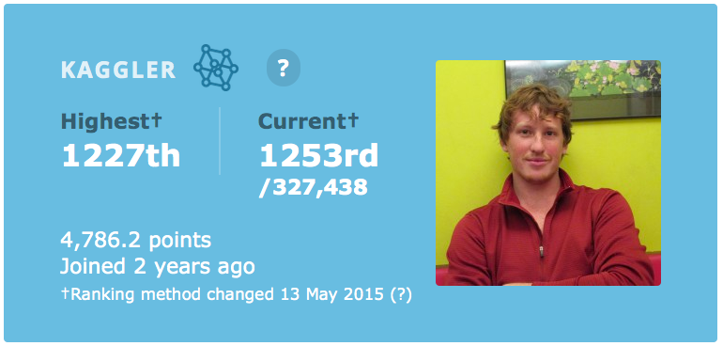

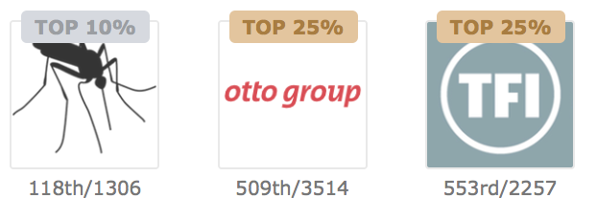
background
Data Scientist at KPMG
Ranked in the top 0.5% of Kaggle
Certified Professional Engineer
BS & MS in Civil Engineering from the University of Illinois at Urbana-Champaign
@erickoziol
ekoziol@kpmg.com
Eric Koziol

Slide 3
Outline
Classification
Random Forest
Metrics/Cross Validation
KNN
Scaling
SVM
Neural Networks
Ensembles

Slide 4
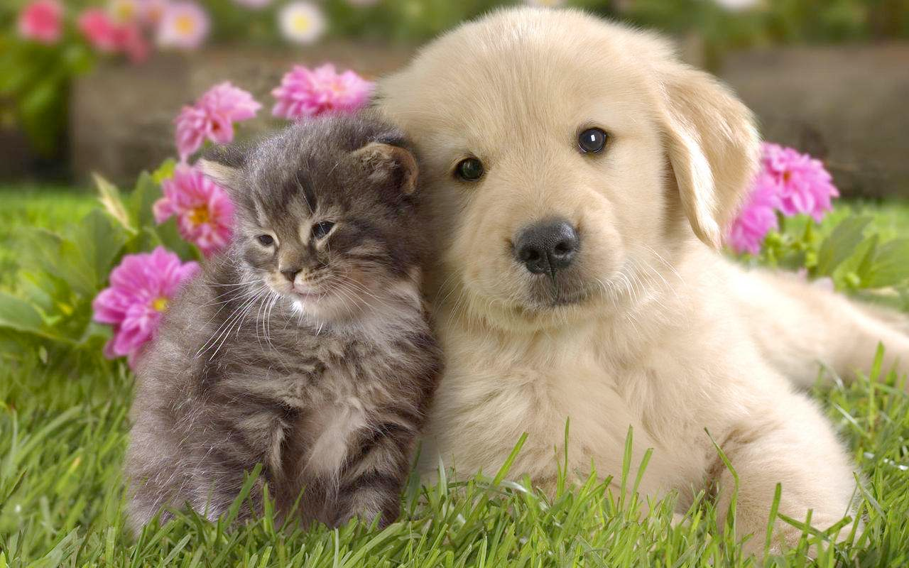
What is Classification?
Determining what categories a given set of data belongs to

Slide 5
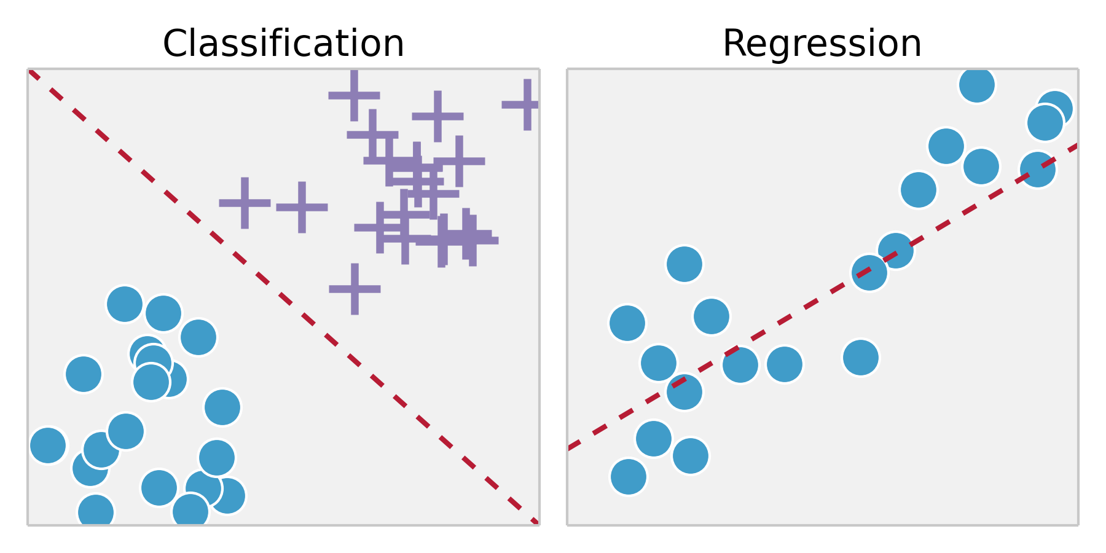
What is Classification?
Classification vs regression

Slide 6
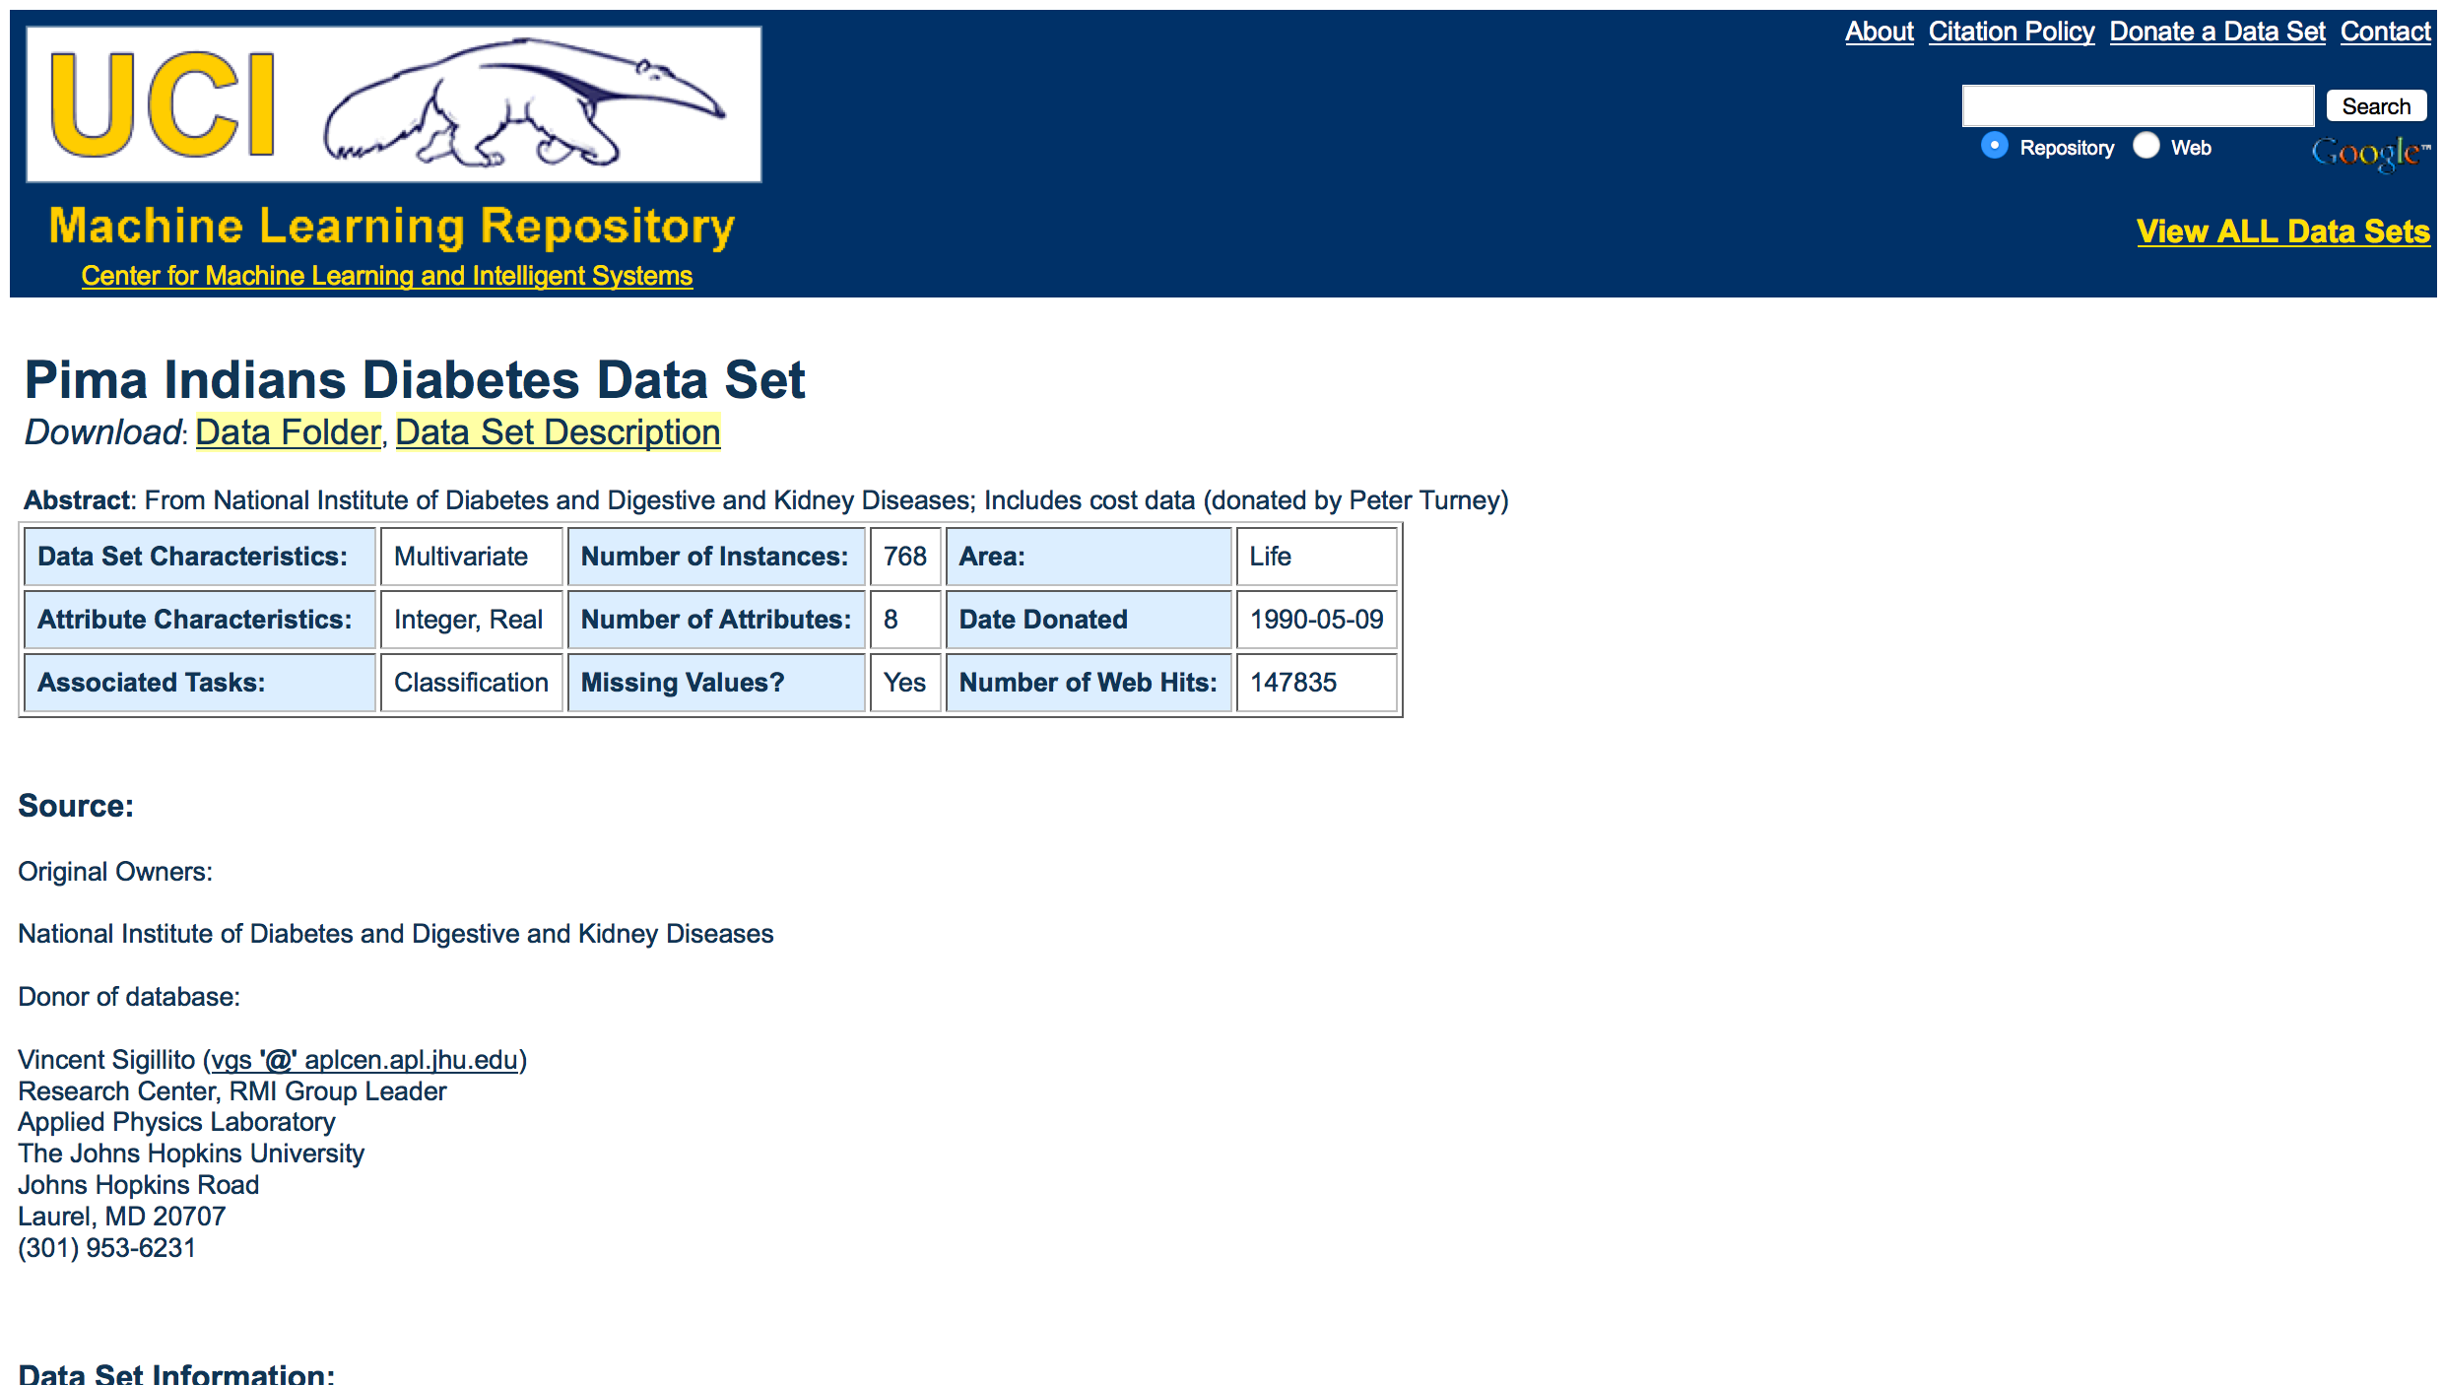
UCI Database
Pima indian diabetes

Slide 7
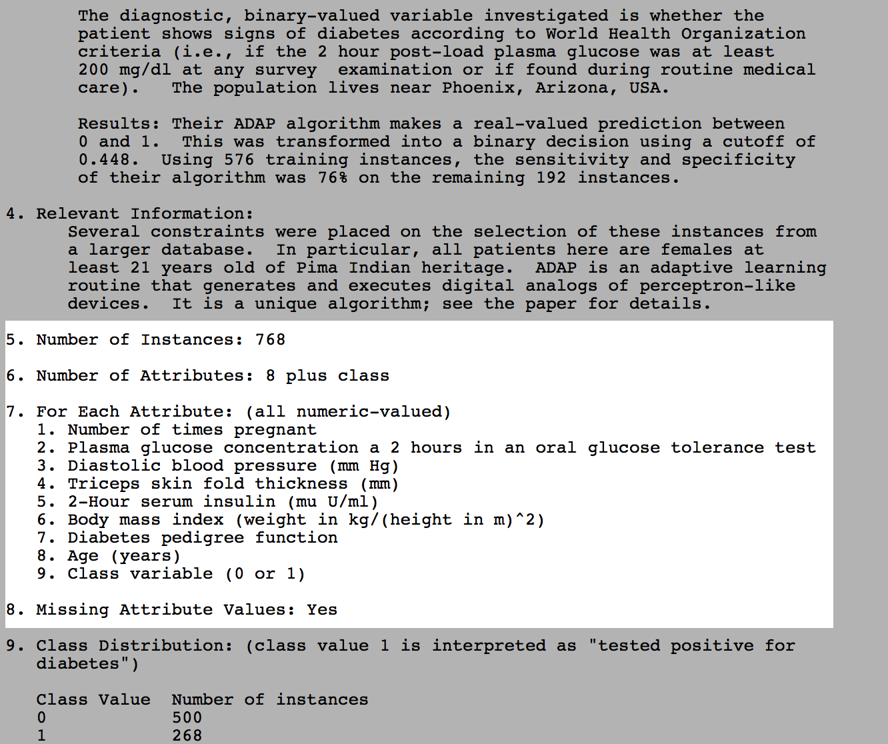
pima indians diabetes
data set description

Slide 8
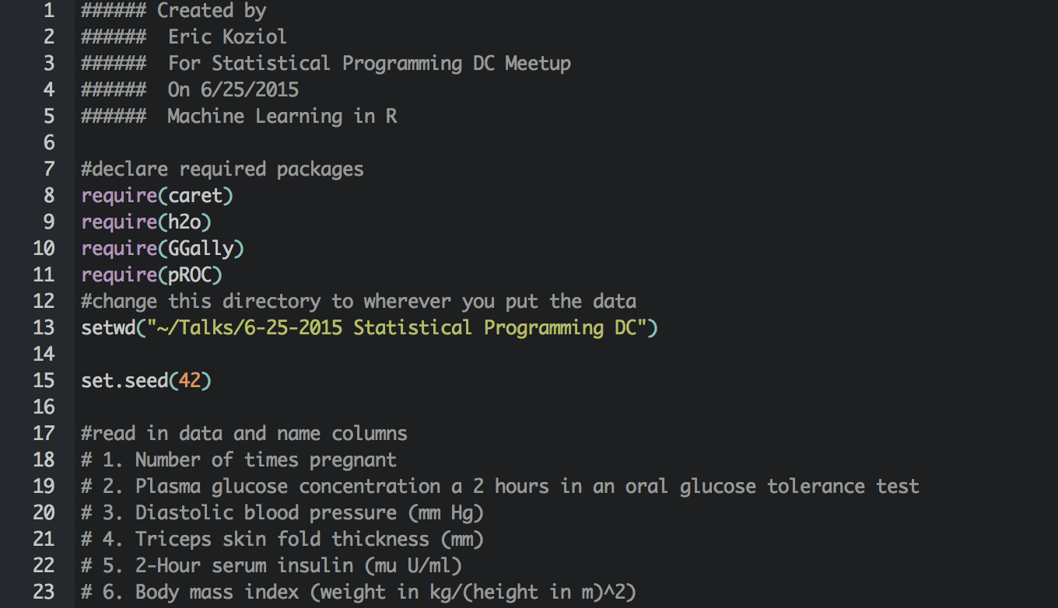
Quick Caret
Simplest Example - load packages

Slide 9
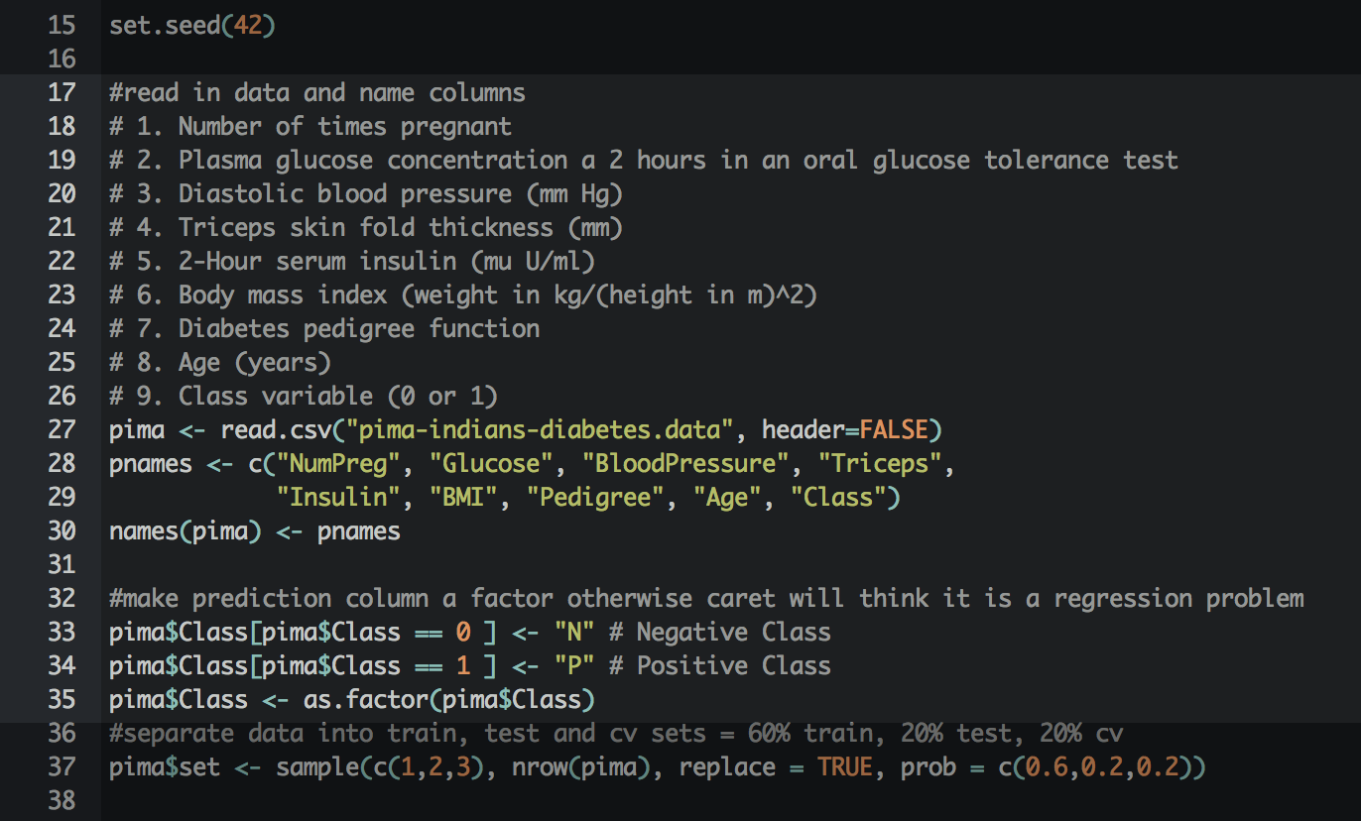
Quick Caret
Simplest Example - prep data

Slide 10
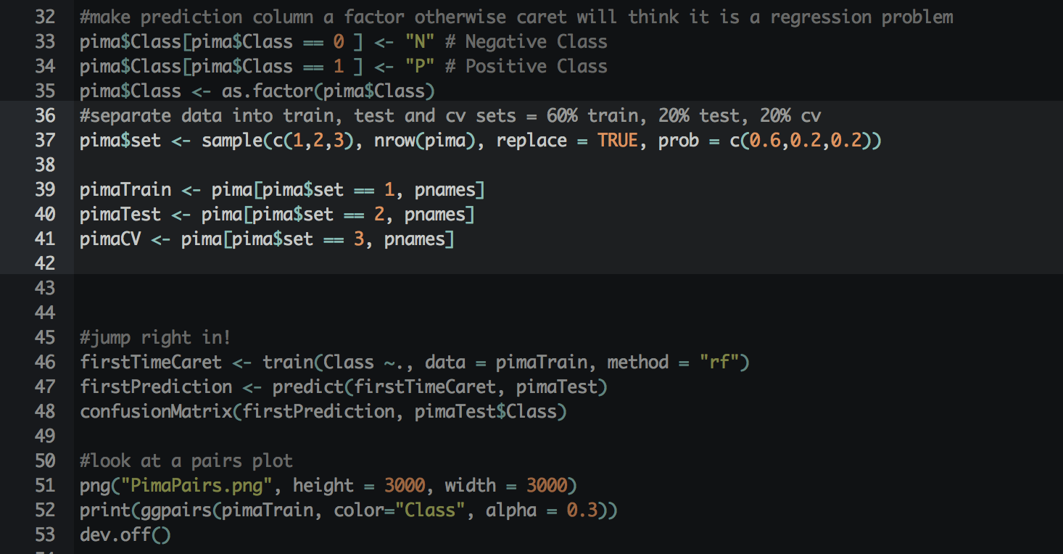
Quick Caret
Simplest Example - split data into train, test, cv sets

Slide 11
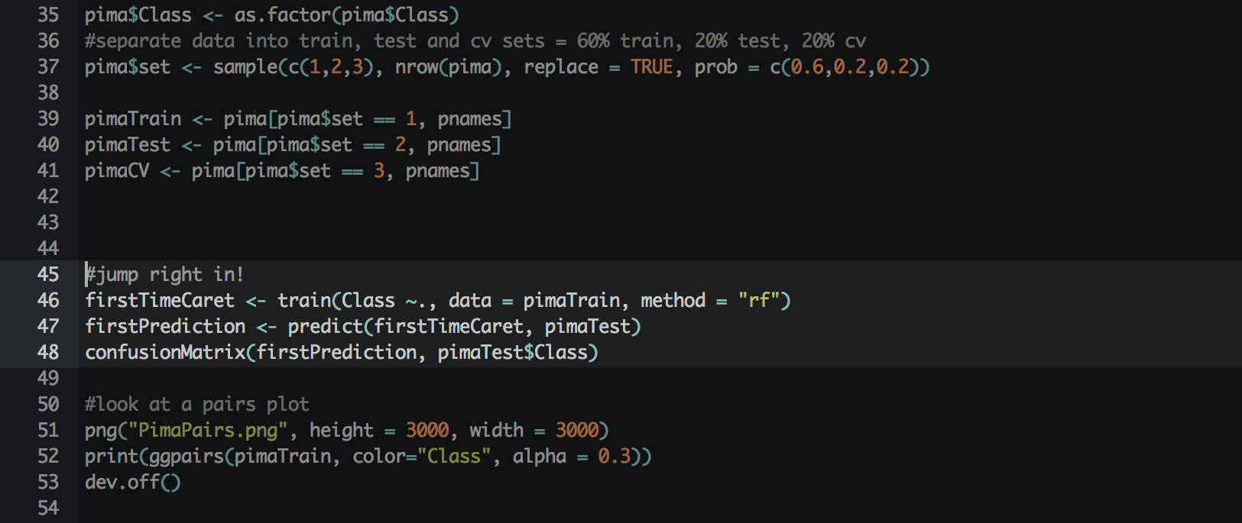
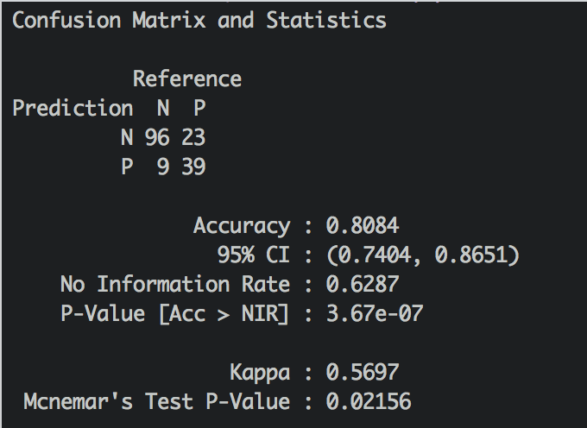
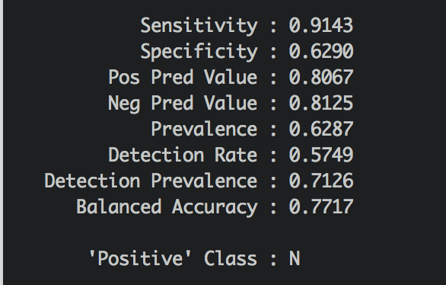
Quick Caret
Simplest Example

Slide 12
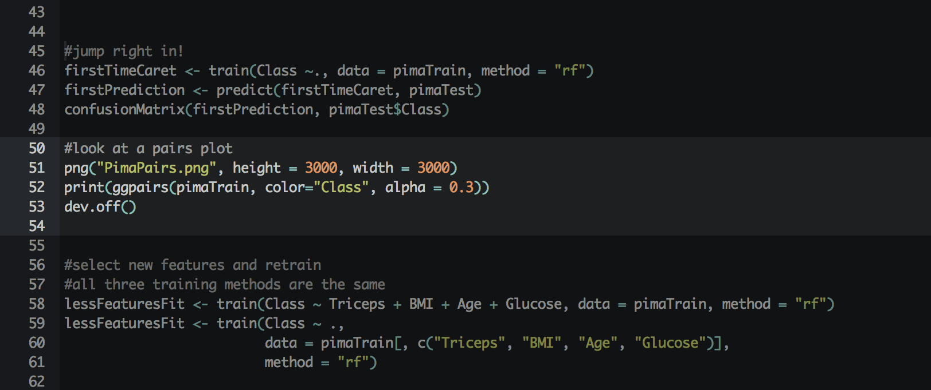
pairs plot
view plot for manual feature selection

Slide 13
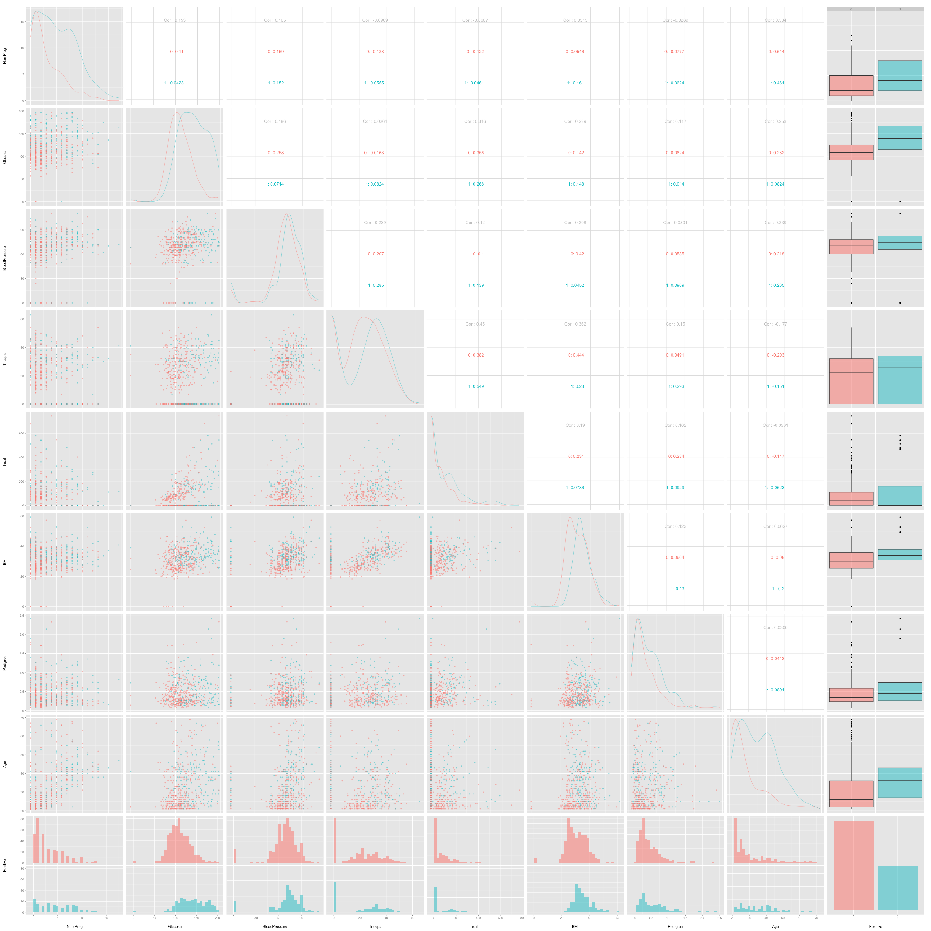
pairs plot
view plot for manual feature selection

Slide 14
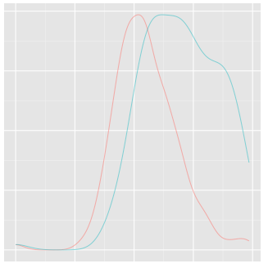
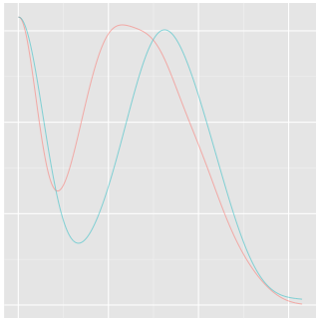
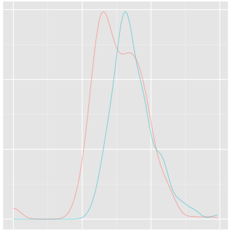
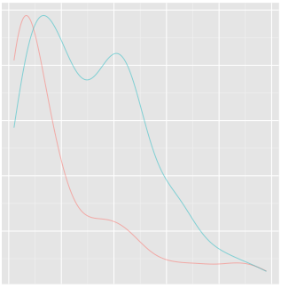
manual feature selection
from ggpairs

Slide 15
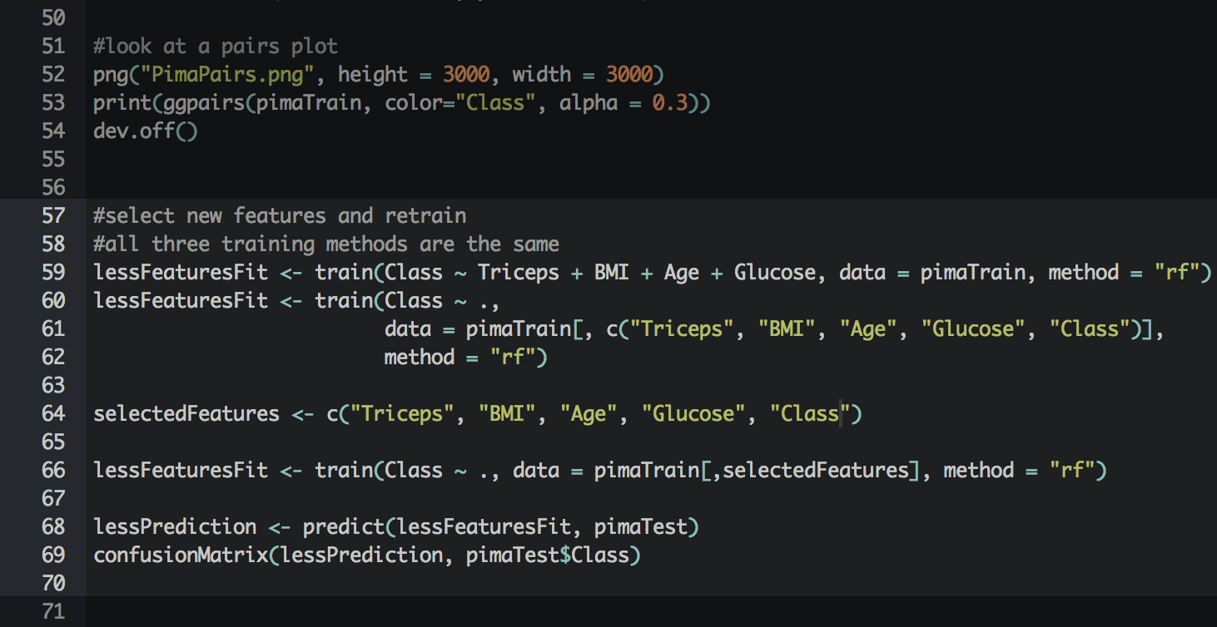
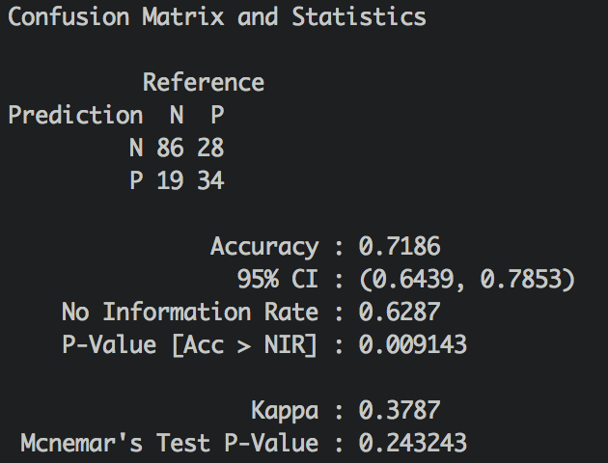
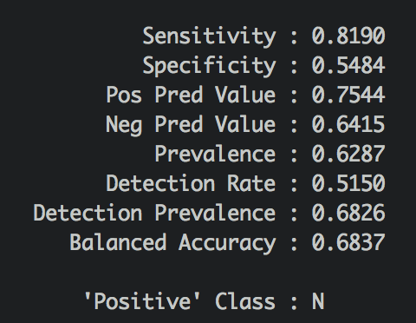
Quick Caret
Simplest Example

Slide 16
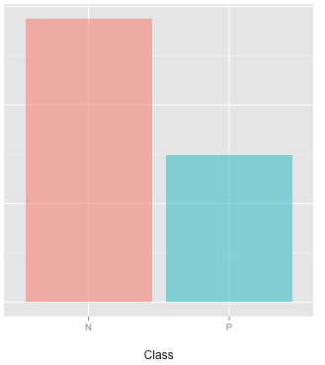
Balanced Datasets
N: 500 | 65%
P: 268 | 35%
Why is balance important?
A trivial classifier that always
chooses the class N will be
accurate 65% of the time
Classification Accuracy

Slide 17
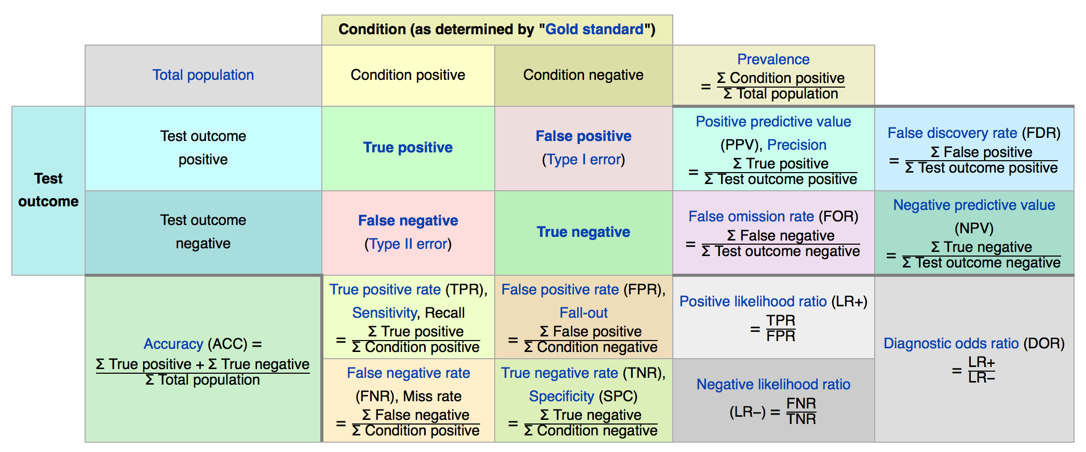
Metrics
Accuracy vs AUC VS others

Slide 18
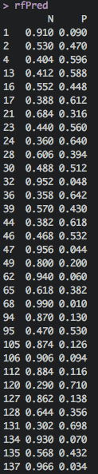
Metrics
Predicted Probabilities

Slide 19
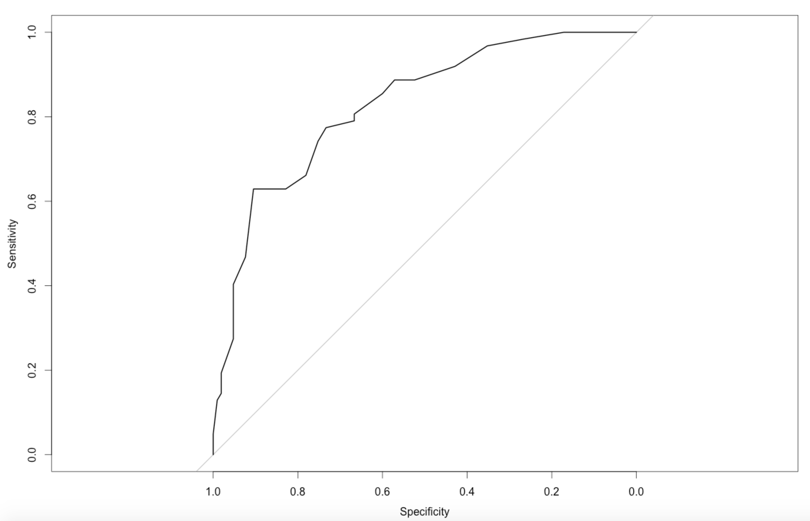
Metrics
Perfect
AUC = 1
Model
AUC = 0.827
Accuracy vs AUC VS others

Slide 20
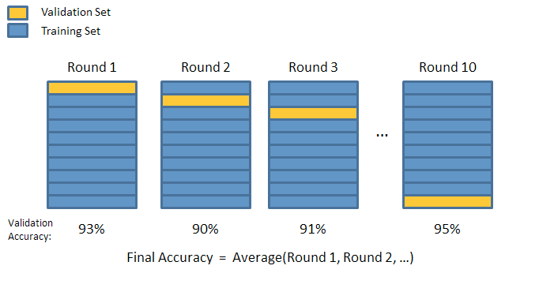
Cross Validation
Avoiding Overfitting

Slide 21
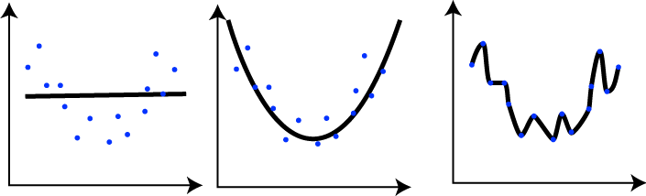
Cross Validation
Underfit
Good fit
Overfit
Avoiding Overfitting

Slide 22
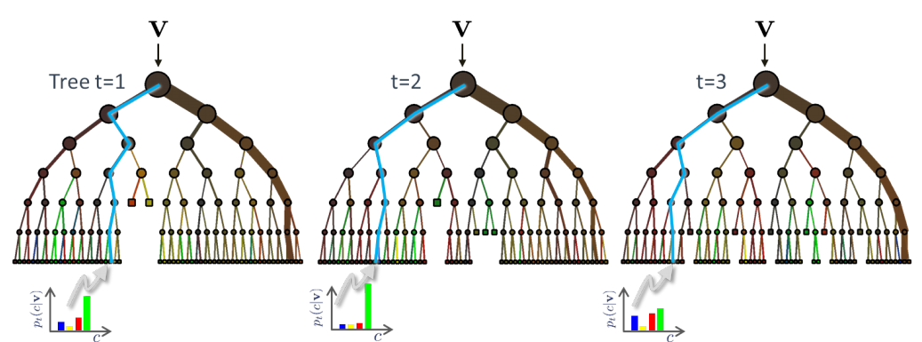
Random Forest
Models

Slide 23
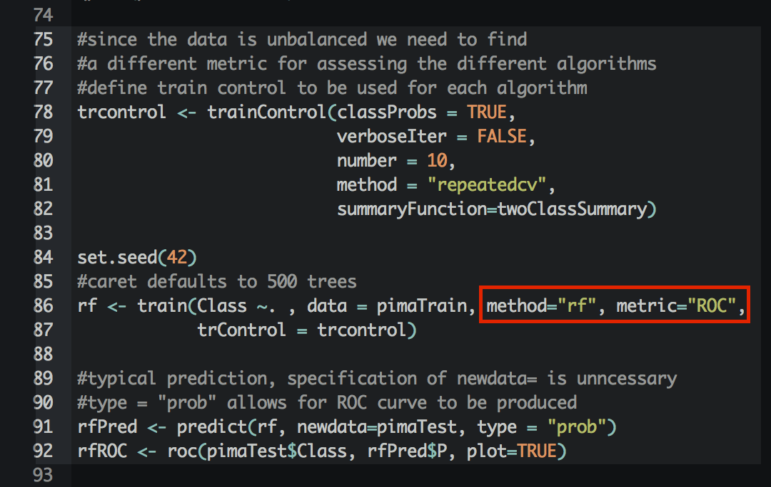
Random Forest
Code

Slide 24
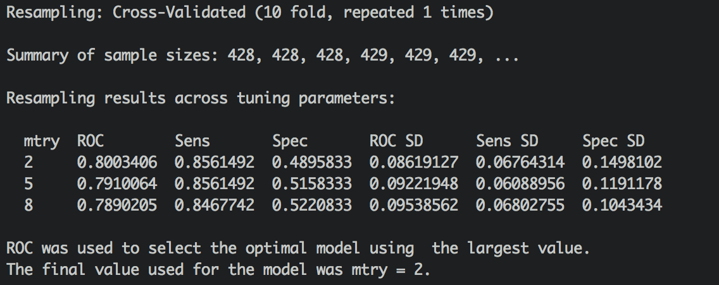
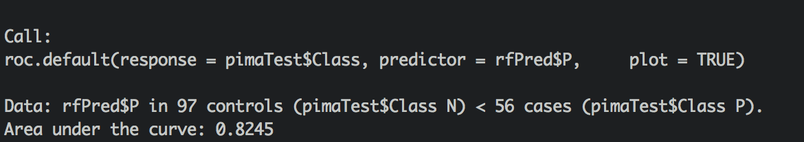
Random Forest
Results

Slide 25
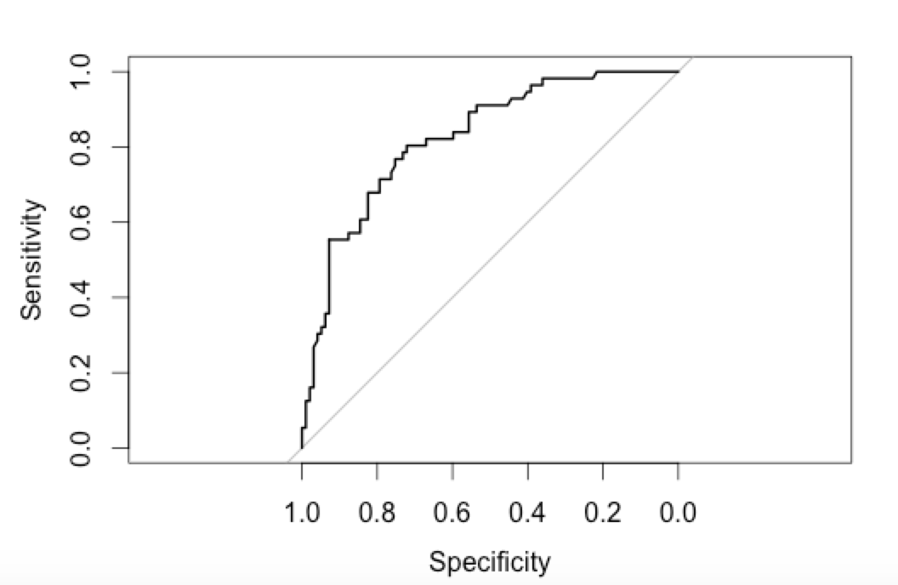
Random Forest
Results

Slide 26
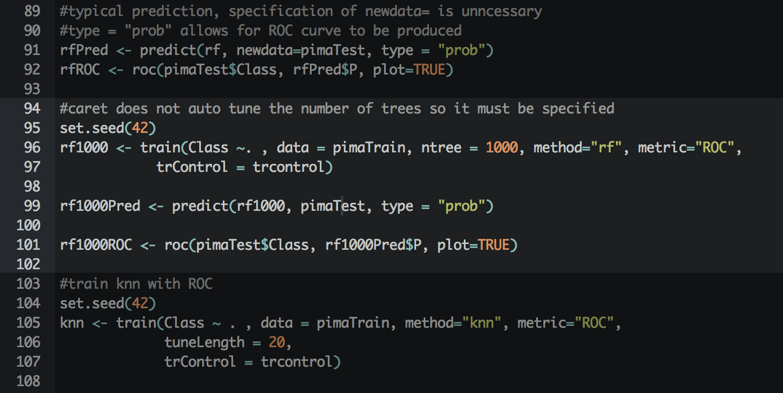
Random Forest
code and Results - Ntree

Slide 27
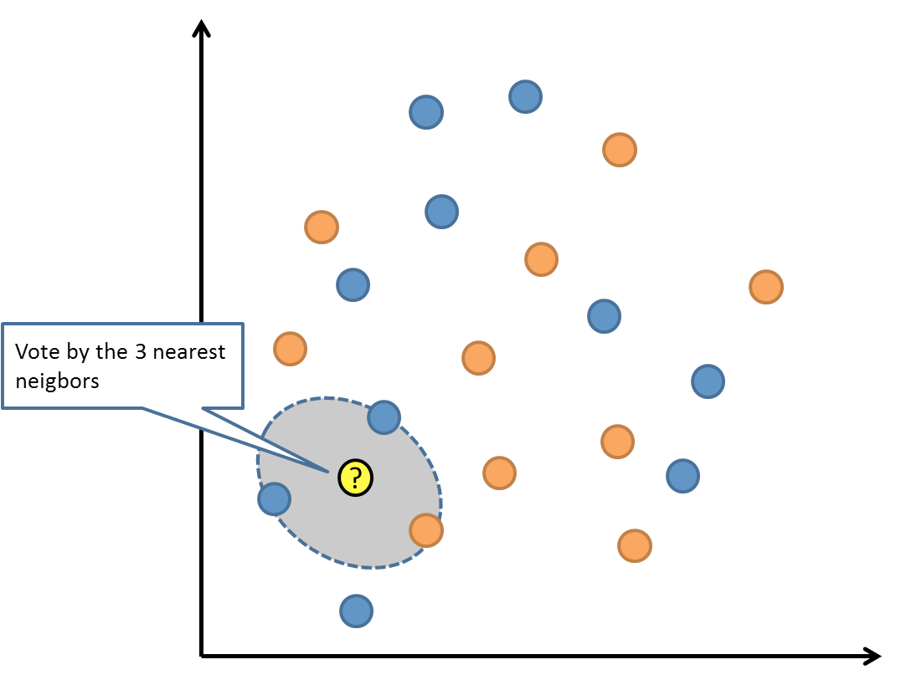
K-Nearest Neighbor
overview

Slide 28
K-Nearest Neighbor
Quick KNN with Gender:
Look at the 3 closest people to you.
Your predicted gender is the gender with the most votes
How accurate is this classifier?
interactive

Slide 29
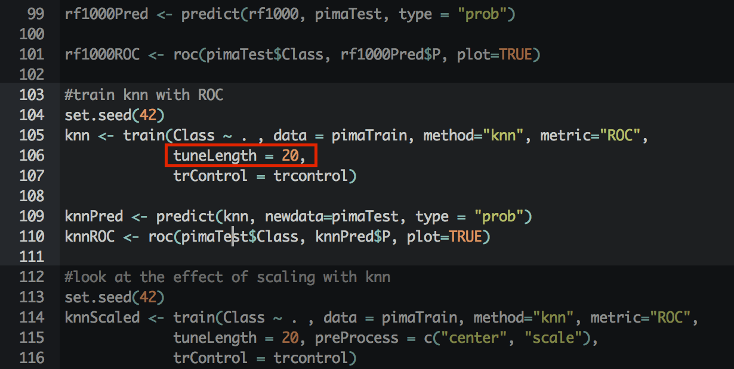
K-Nearest Neighbor
code

Slide 30
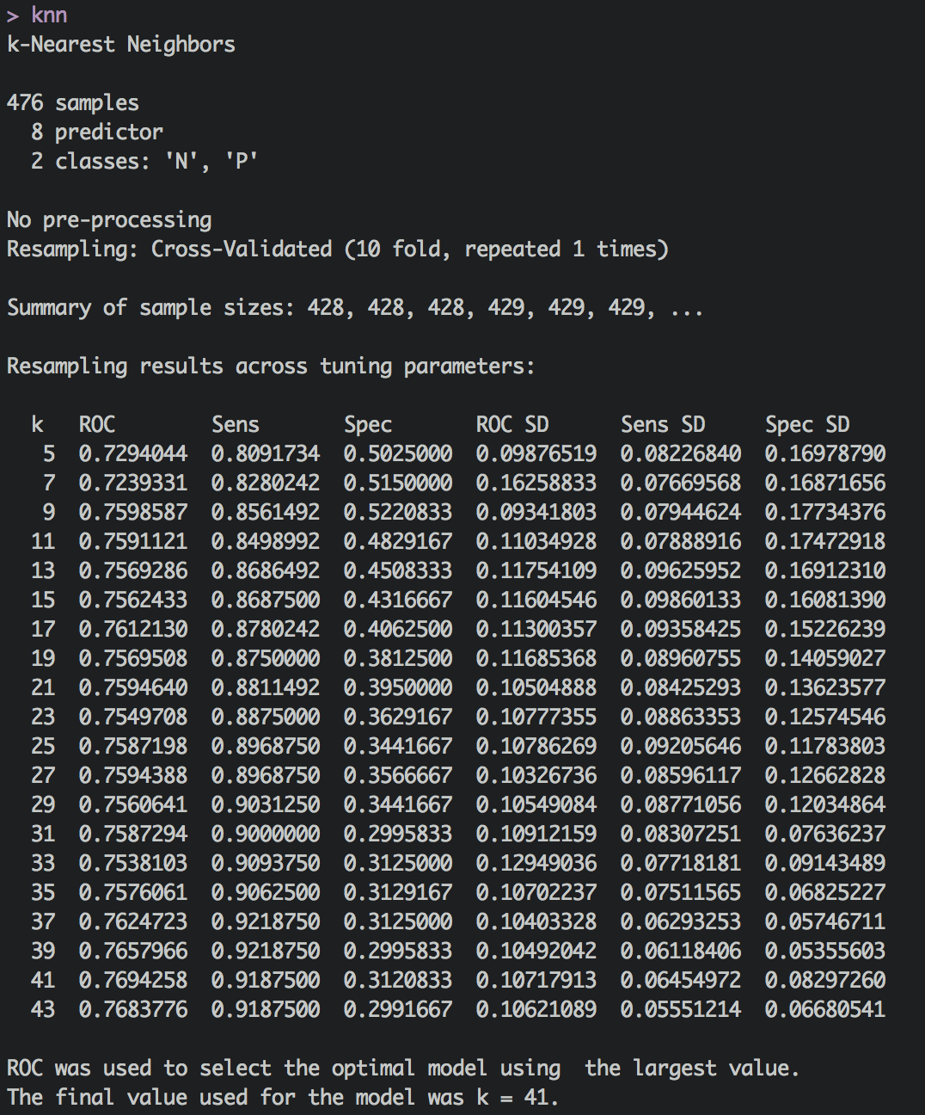
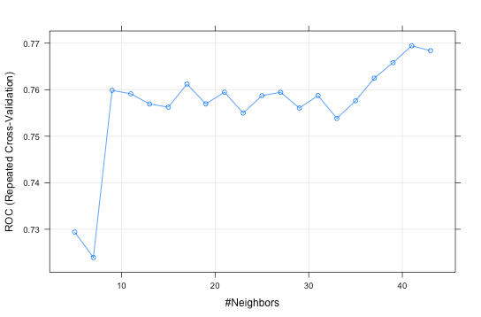
K-Nearest Neighbor
results

Slide 31
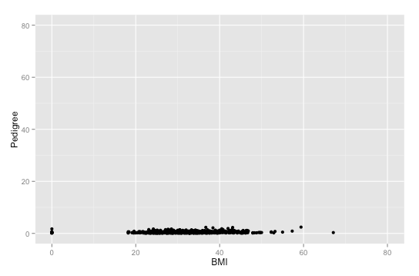
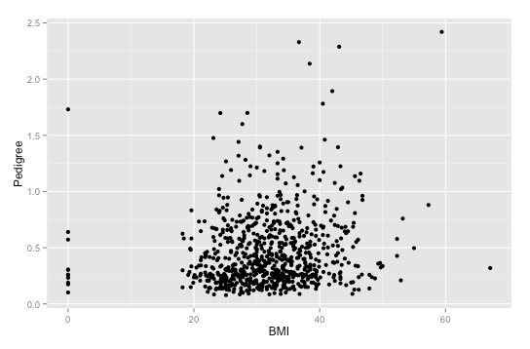
K-Nearest Neighbor
Why scaling matters
Not Scaled
Scaled
Scaling

Slide 32
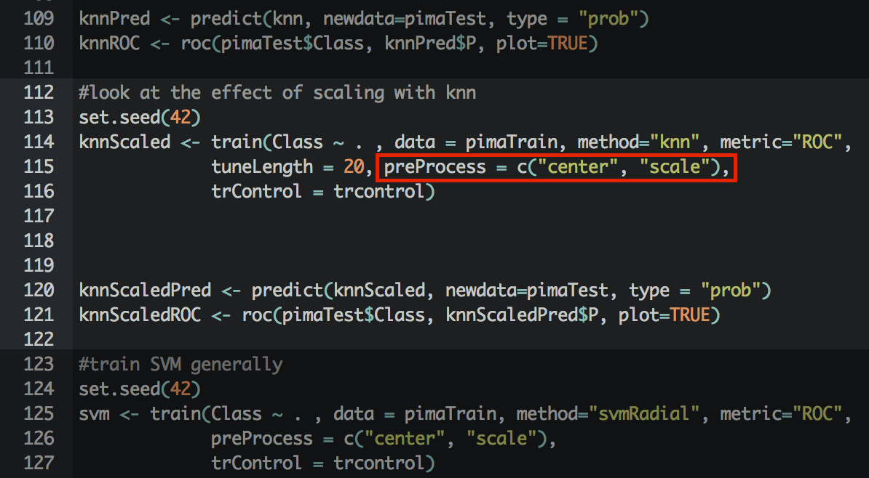
K-Nearest Neighbor
Scaled implementation

Slide 33
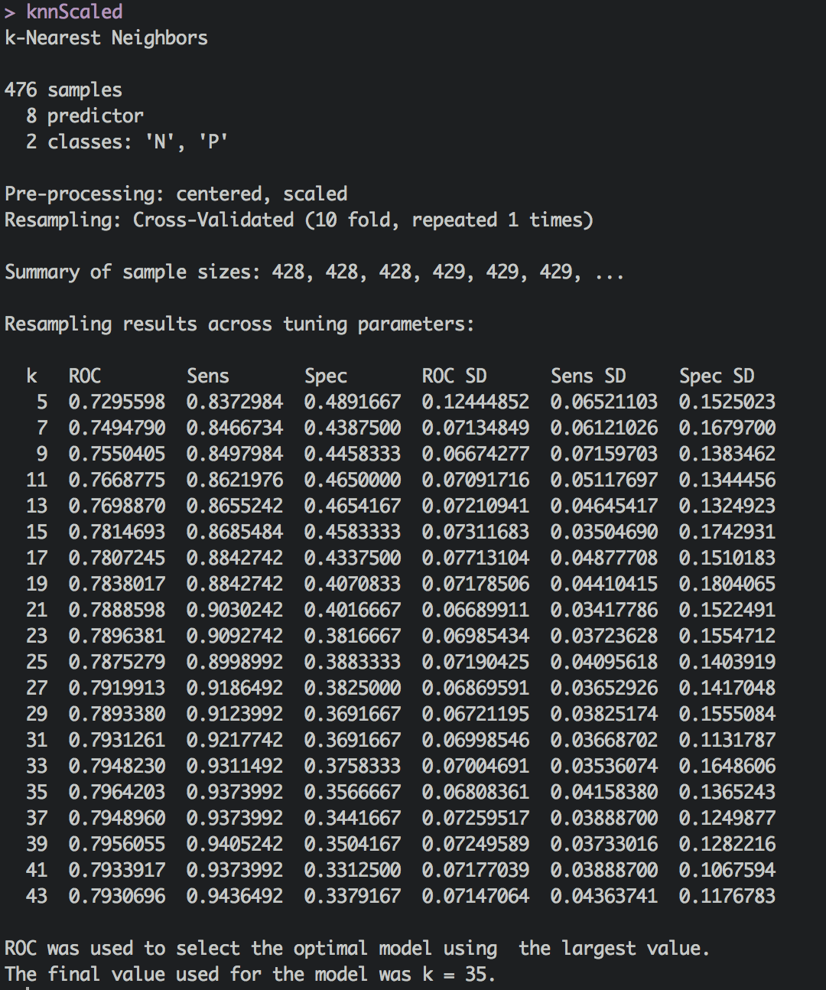
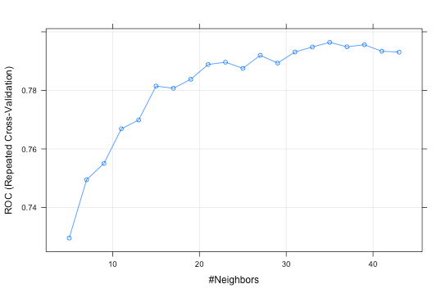
K-Nearest Neighbor
Scaled implementation - results

Slide 34
K-Nearest Neighbor
KNN Unscaled
KNN Scaled
Area under the curve: 0.7781
Area under the curve: 0.8119
Comparison

Slide 35
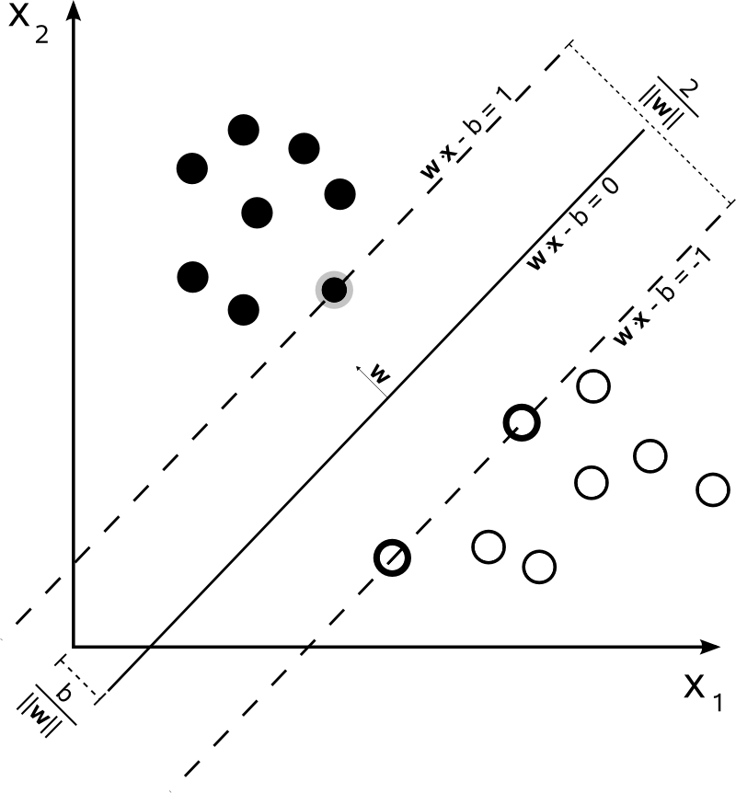
Support Vector Machines
Models

Slide 36
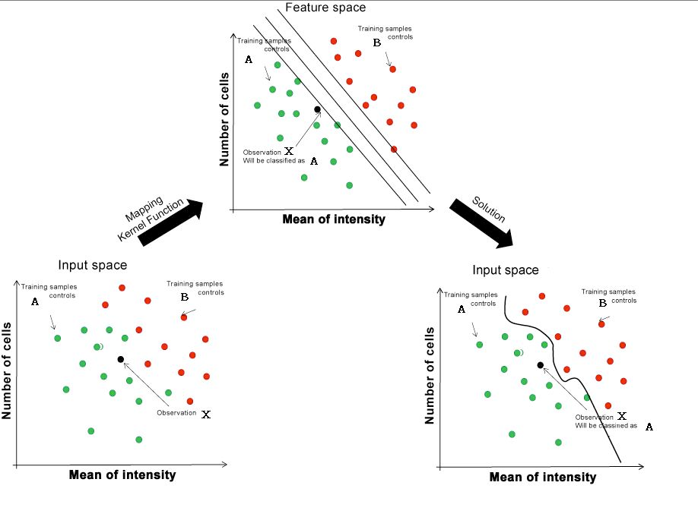
Support Vector Machines
Models

Slide 37
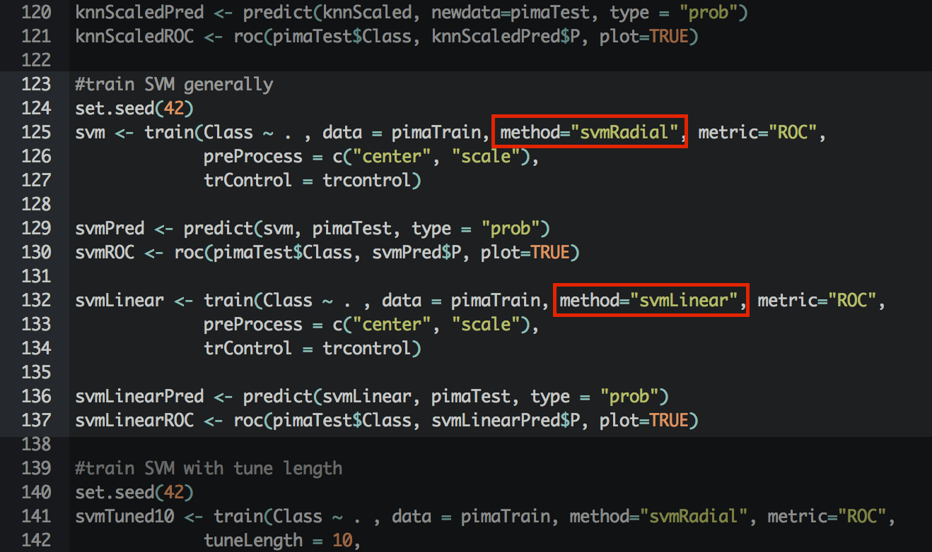
Support Vector Machines
Code

Slide 38
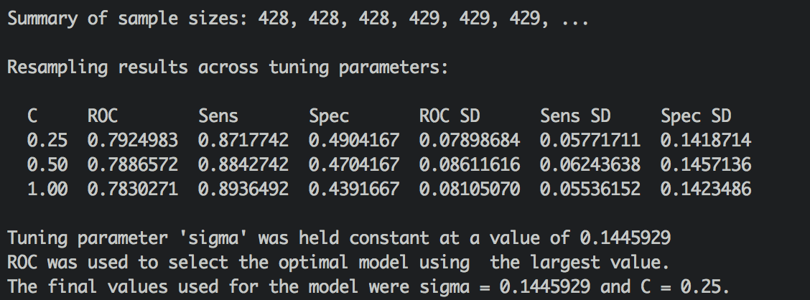
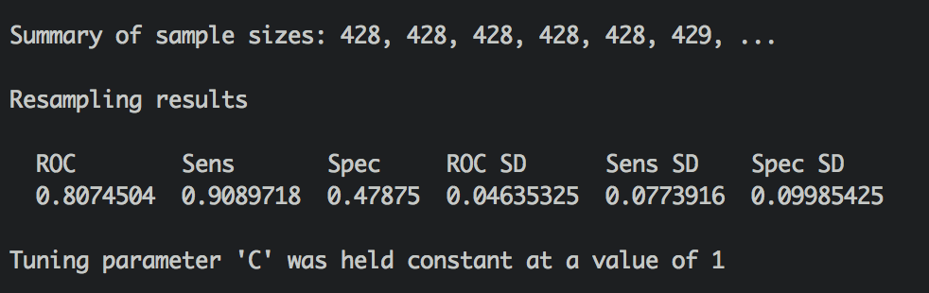
Support Vector Machines
RBF Kernel
AUC: 0.8312
Linear Kernel
AUC: 0.8279
Results

Slide 39
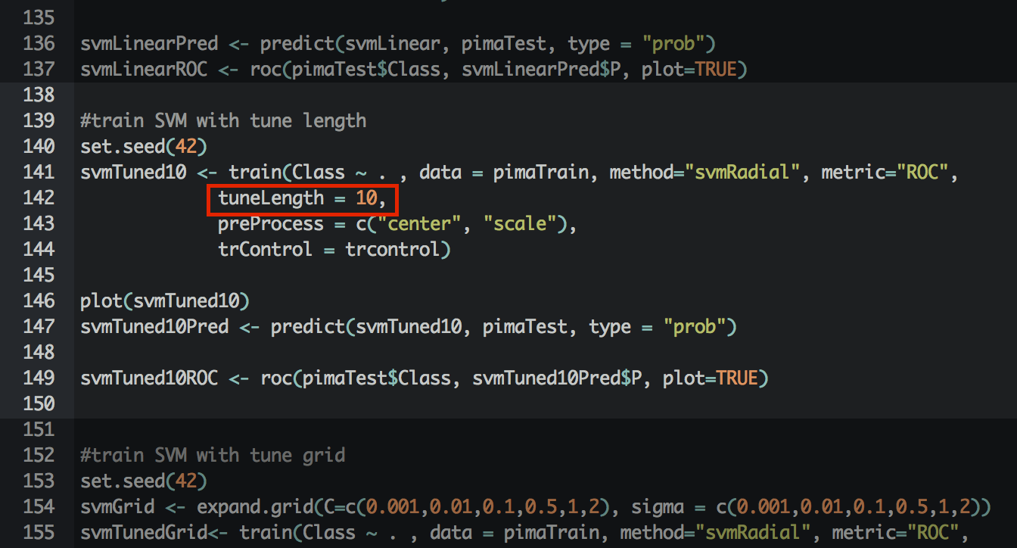
Support Vector Machines
Tuning

Slide 40
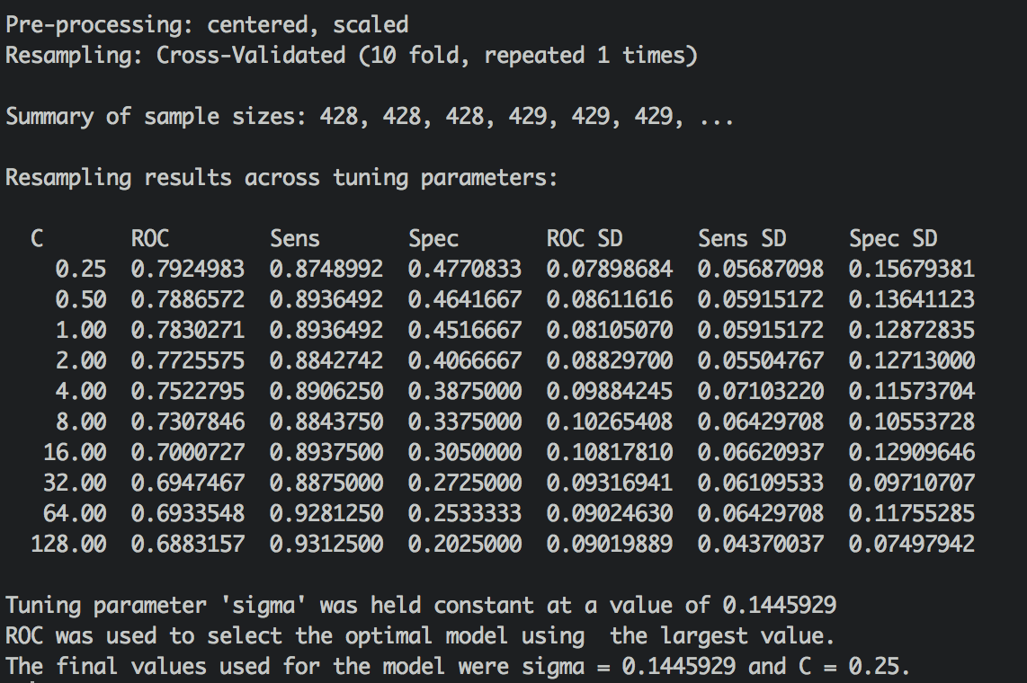
Support Vector Machines
AUC: 0.8312
Tuning

Slide 41
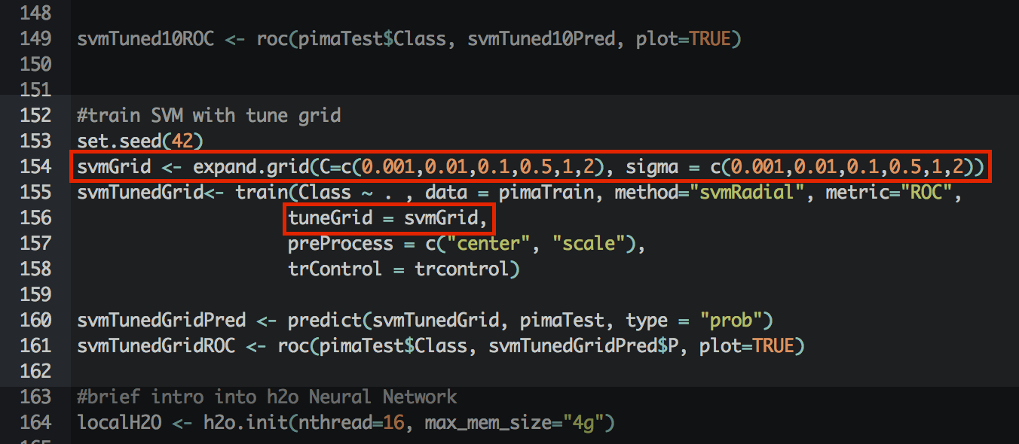
Support Vector Machines
Tuning

Slide 42

Support Vector Machines
AUC: 0.8268
Tuning

Slide 43
Support Vector Machines
RBF Kernel
Out of the box
AUC: 0.8312
RBF Kernel
Auto tuned
AUC: 0.8312
Linear Kernel
Out of the box
AUC: 0.8279
RBF Kernel
Manual Grid
AUC: 0.8268
Comparison

Slide 44

Neural Networks
Models

Slide 45

Neural Networks
Code

Slide 46

Neural Networks
AUC: 0.8276
results

Slide 47

Ensembles
Combining Models

Slide 48

Ensembles
Area under the curve: 0.8341
Code

Slide 49
Model Comparison
Model | Test AUC
Random Forest | 0.8245
Random Forest 1000 | 0.8276
KNN | 0.7781
KNN Scaled | 0.8119
SVM Radial OOB | 0.8312
SVM Linear OOB | 0.8279
SVM Tuned 10 | 0.8312
SVM Tuned Grid | 0.8268
h2o Neural Network | 0.8276
Ensemble Blend | 0.8341
Code

Slide 50
Model Comparison
Model | Test AUC | Hold Out AUC
Random Forest | 0.8245
Random Forest 1000 | 0.8276 | 0.8698
KNN | 0.7781
KNN Scaled | 0.8119 | 0.8415
SVM Radial OOB | 0.8312 | 0.8768
SVM Linear OOB | 0.8279
SVM Tuned 10 | 0.8312
SVM Tuned Grid | 0.8268
h2o Neural Network | 0.8276 | 0.8778
Ensemble Blend | 0.8341 | 0.8843
CV Holdout set

Slide 51
Questions?
@erickoziol
ekoziol@kpmg.com

